Slide 1

LAB Vessels, Ch. 20
NO VISIBLE BODY THIS WEEK☺ Lets do some practice together.
Blue and Red pens anyone?
Blood Extra Credit due!
Thanks, on behalf of humanity… for donating.

Slide 2
Setting up for Success
Week 6: October 2 and 4 | Vessels: Read 20. Sections 1-6 Artherosclerosis article, osmotic exchange. Your work on vessels is largely Anatomy and Memorization using Visible Body and the blank diagrams. | RRM 20 and NO VB Quizzes Start Vaccine/Immune System paper SKIP Case; COVID Serology (see directions on Moodle)
 |  | LAB A: PhysioEx 5 Act 4-7 only. PRE-READ! Lab B: diagram NO Visible Body
Week 7: Oct. 9 & 11 | Lymphatic and Immunity Read 21 Sections 1 and 2, and 22 Sections 1-4, 7. | RRM 21 & 22, videos and images on HIV and inflammation
 |  | LAB: PhysioEx 12 Do Act. 1,3,4 only Ch. 22 (only) Visible Body

Slide 3
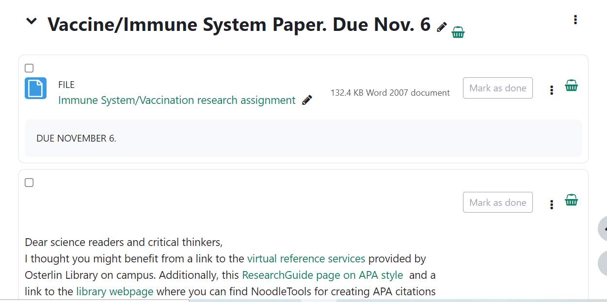
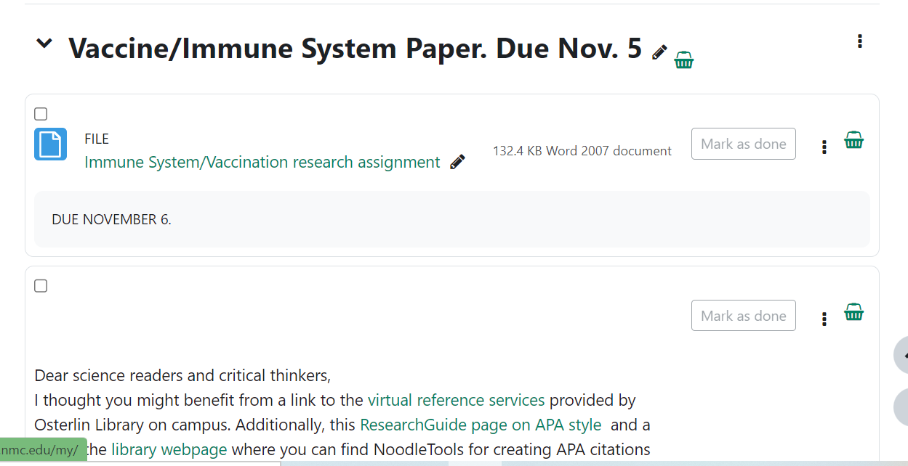
Immunity Science Summaries
ONLINE CLASS
HYBRID CLASS

Slide 4
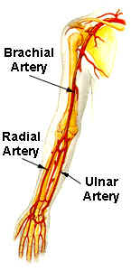
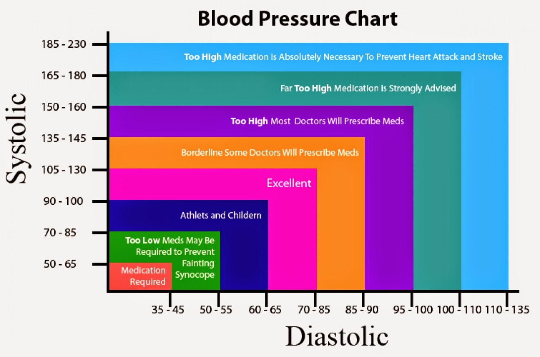
Distinctions: HR, BP, pulse
Heart rate=beats per minute (bpm)
Pulse=HR in bpm, via radial artery wrist or
carotid artery in neck
BP=Blood pressure or pressure in the
120/80mmHg is normal
Systole=P. of blood on vessels, when
blood into arteries (heart contracting)
Diastole=P. when heart relaxes

Slide 5
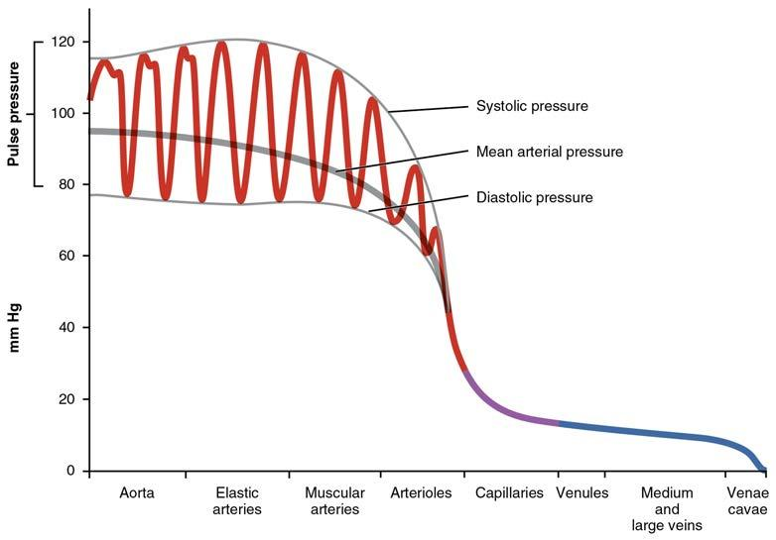
Pressure

Slide 6
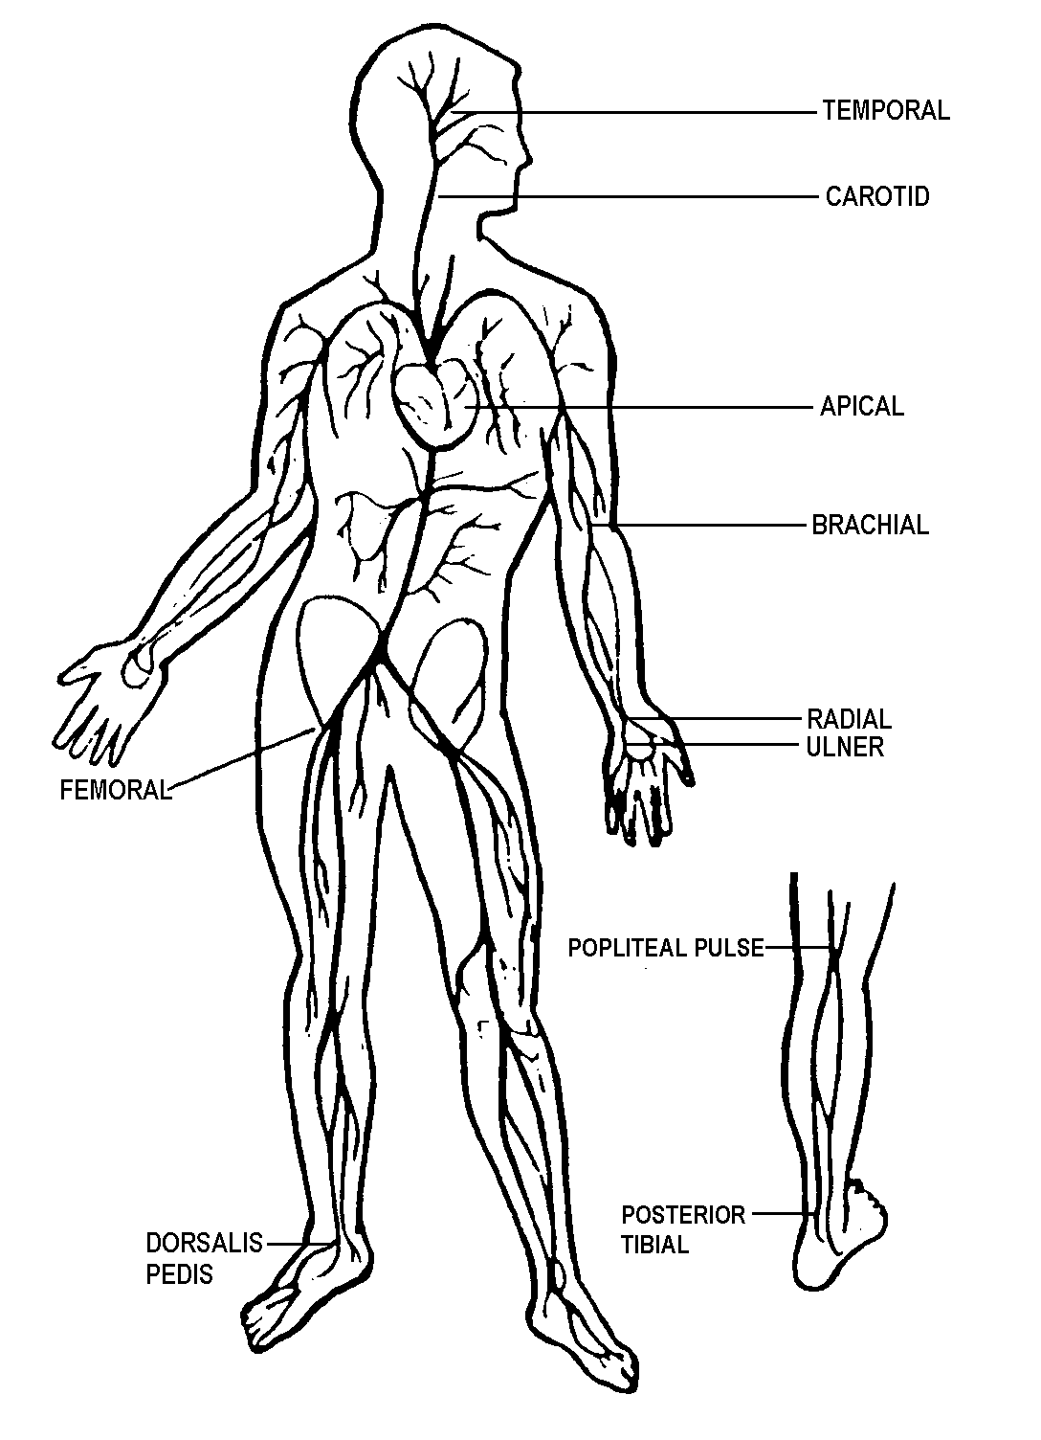
Pulse points: you already know many of these arteries.

Slide 7
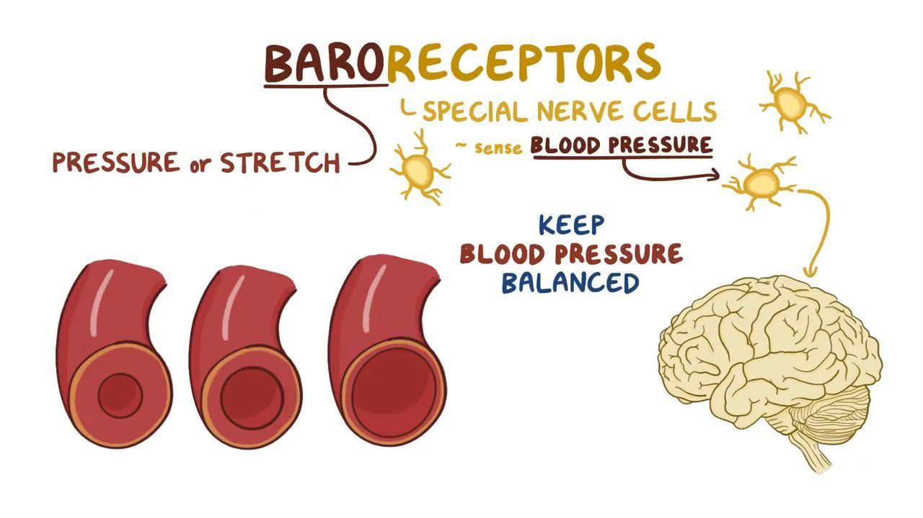

Slide 8
Compliance: Vessels act differently than Heart
…ability of a compartment to expand to accommodate increased content. Vasoconstriction and Vasodilation can change rapidly
If an artery is compliant it can expand to accommodate surges in blood flow, while keeping BP (and resistance) consistent.
(Amazing, no?)
Veins are more compliant than arteries.
Atherosclerosis decreases compliance.

Slide 9
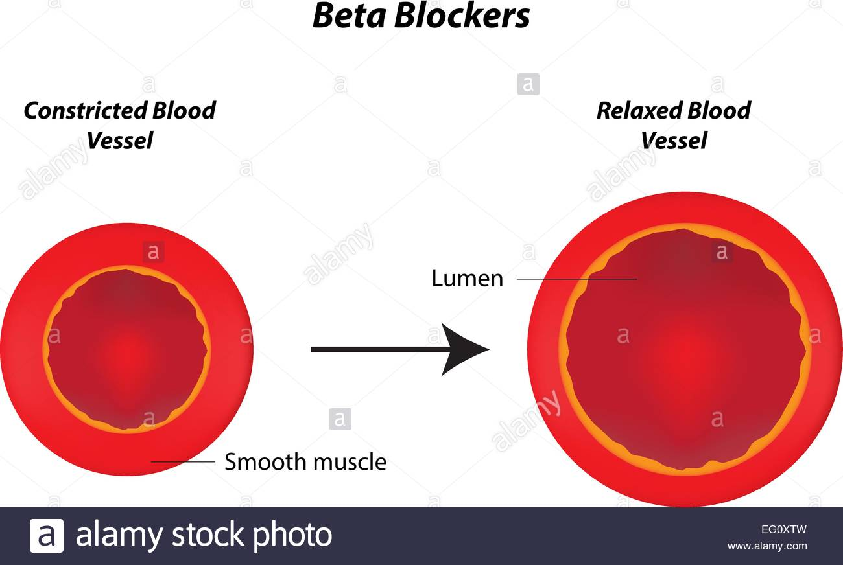
Arteries (smaller lumens, thicker walls) versus Veins (Large lumens and thinner walls)
Veins have muscles around exterior-COOL! –to move blood against gravity.
Note diff. between “Constrict” and “relax”

Slide 10
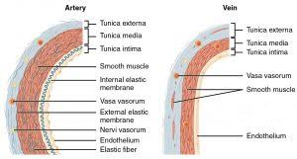
Tunicas: Capillaries only have one (intima)

Slide 11
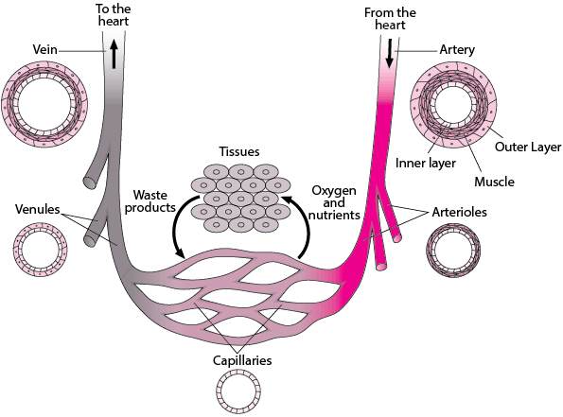
20.1
NOTE how Arteries-Arterioles (See lumen layers, which are called “tunics”.
What connects them?
Capillaries are only one layer thick and one cell wide.
Venules-Veins

Slide 12
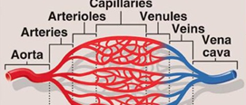
20.1
Arteries AWAY
Veins TOWARD HEART

Slide 13
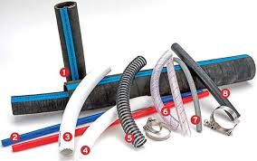

NEW 20.2. Blood Flow, BP and Resistance I know you’ve got this. Don’t complicate it.

Slide 14

20.2 Vessels and Resistance: THINK-What can slow down blood flow? (mathematic, or practical)
Note: Veins are called “capacitance” vessels. They have thinner walls, can stretch easily and therefore can hold a lot-capacity.
Increase Pressure Flow
Volume Increase Increase
Resistance/Viscosity Increase Decrease
Length Decrease Decrease
Diameter________Decrease_____________Increase
*remember that contraction decreases dia. & relaxation increases it. Vascular tone is ability to contract

Slide 15
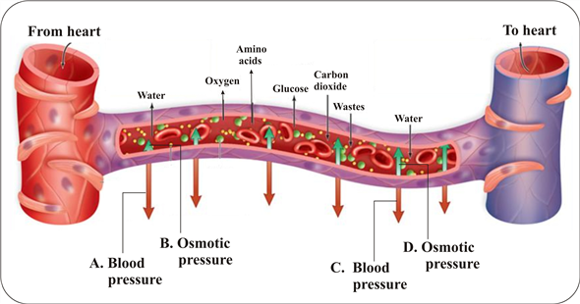
20.3 Capillary Exchange: Filtration (OUT) and RE-absorption (IN)
Movement in and out of capillaries is run by Hydrostatic P (P. of fluid in a space) and Osmotic P(you know this!)
Arterial end: Filtration Venule end-reabsorption

Slide 16
Pressure

Slide 17
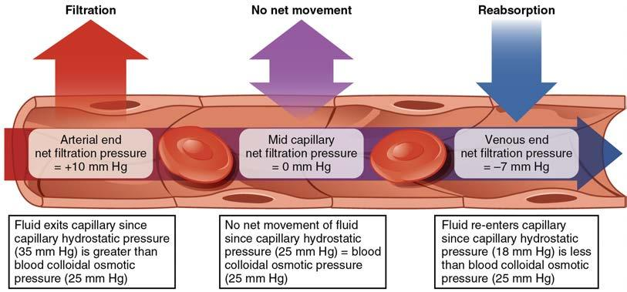
NFP: is the fluid filtering out, or being reabsorbed in here, or both? BCOP=Colloidal P (osmotic) and BHP=Hydrostatic P.

Slide 18
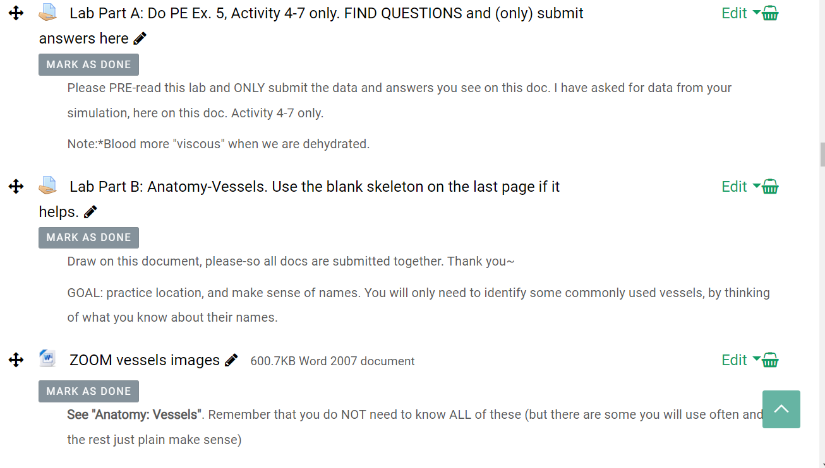
Lab: TO DO 2 items on Moodle

Slide 19
LAB part A: Pre-Read and Submit this sheet ONLY for Physio Ex 5 CardioVascular Dynamics Act. 4-7 and SUBMIT this sheet LAB part B: VIDEO and DIAGRAM labeling also
228 Cardiovascular Dynamics Lab #5. Using PhysioEx. Act. 4, 5, 6 & 7.
Read through this doc first. Answer and Submit these questions
Pre-lab questions.
Recall that blood temp is about 100! Why? ________________________
Please define inversely proportional:
Please define directly proportional:
a. If 6/3=2, when you increase 3, what happens to your answer?
b. When you increase 6, what happens to your answer?
Which is A. above, directly or inversely proportional?

Slide 20
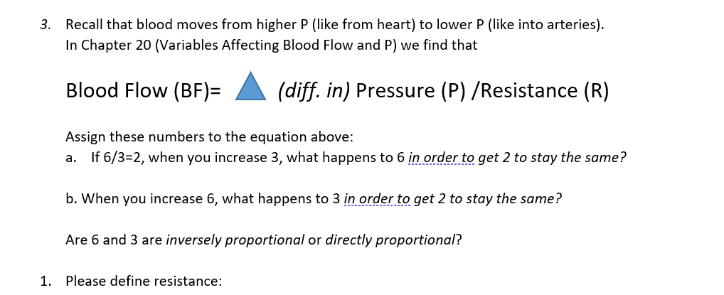
From PE Lab

Slide 21
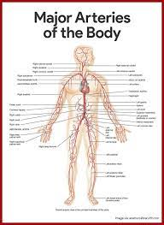
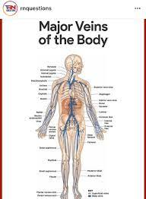
Anatomy Please see Fig 20.24 and Fig. 20.35 KNOW MAJOR Vessels, by understanding word cues.

Slide 22
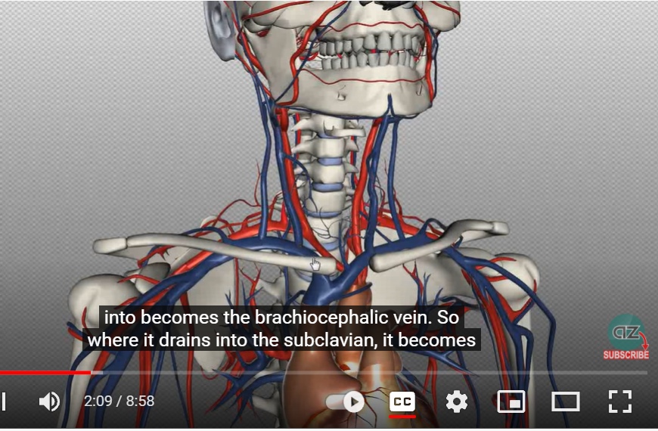
As promised….Lab Anatomy “with video”
GOAL: practice location, naming and flow from sup.-inf.
What makes sense? This is learning. You do NOT NEED TO KNOW ALL VESSELS. But if I give you clues about major vessels, you should be able to decipher where it is.

Slide 23
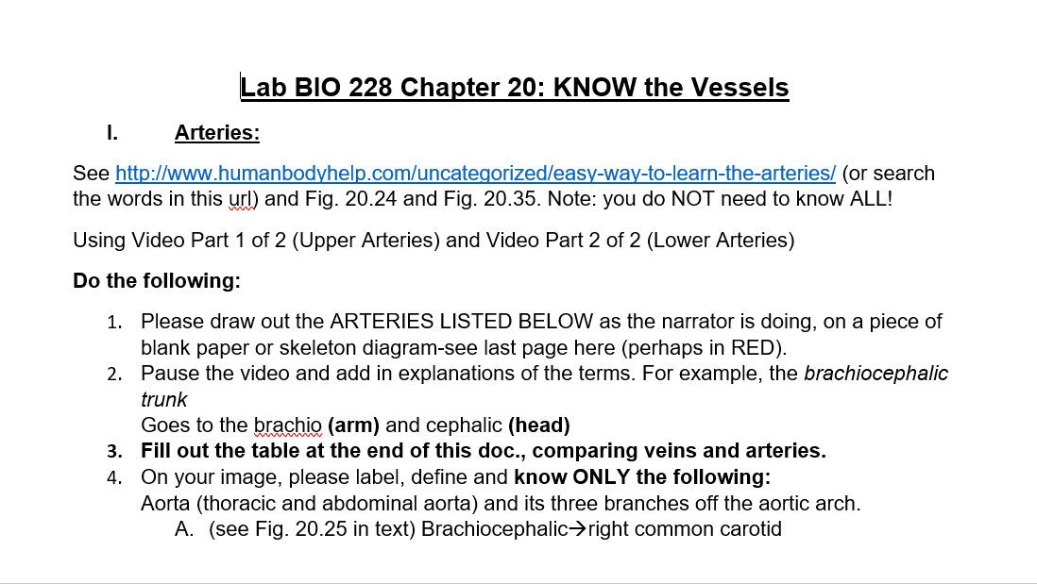
Lab Anatomy B p. 1

Slide 24
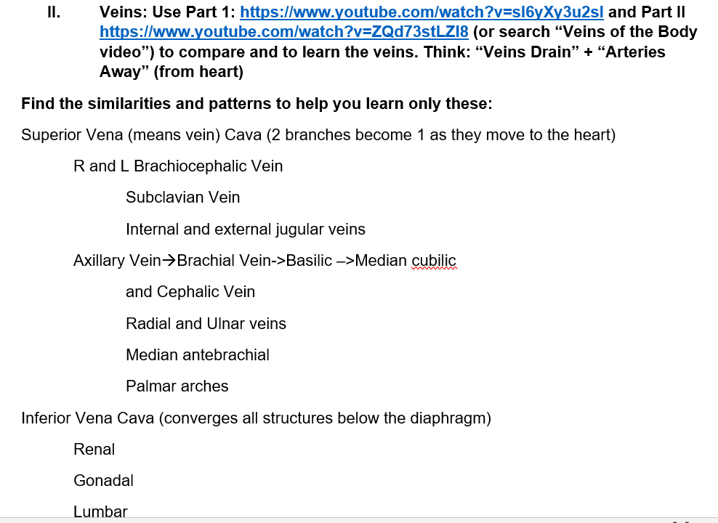
Lab Anatomy B p.2

Slide 25
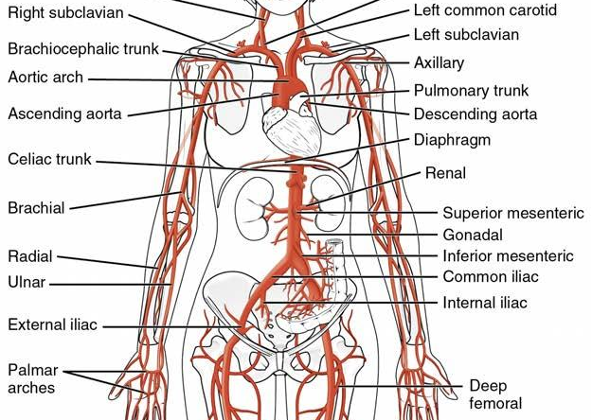
YIKES! Make sense of it

Slide 26
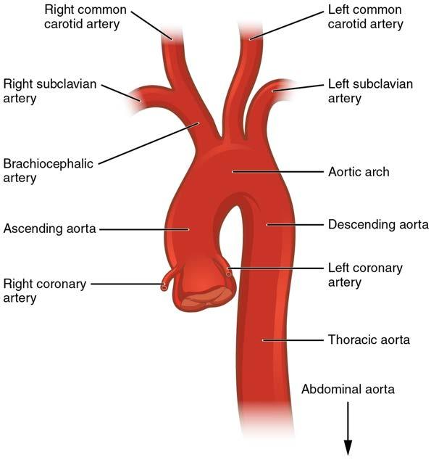
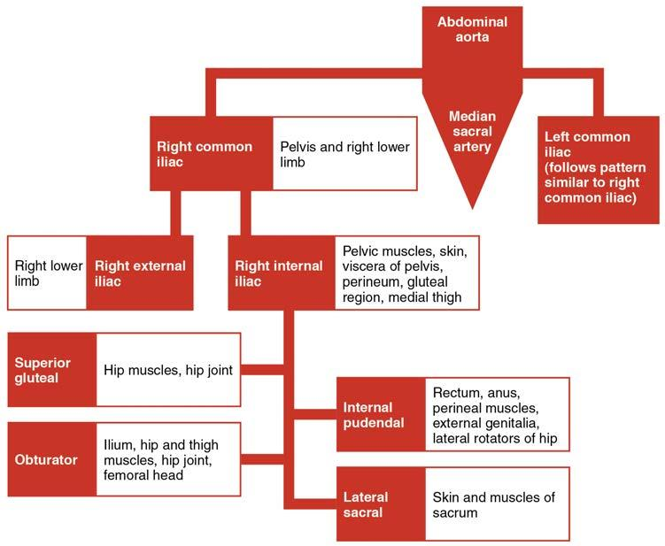
Drawing it out, spatially, from superior to inf.

Slide 27
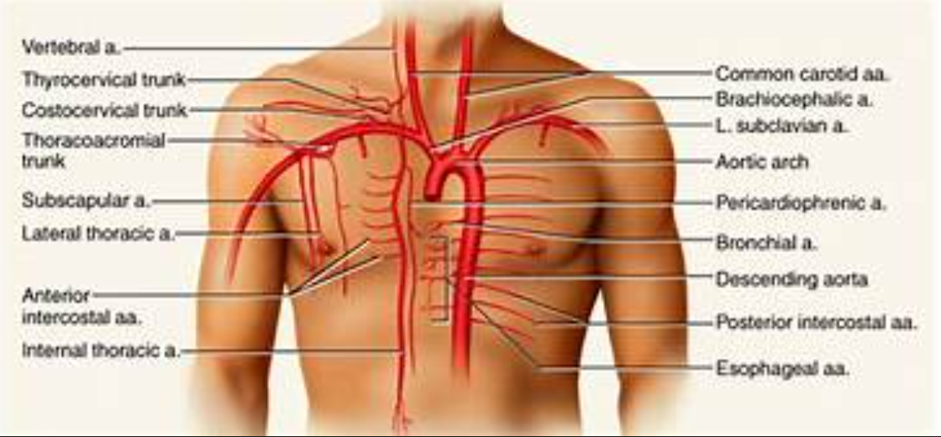
What makes sense given your knowledge of Anatomical Language?

Slide 28
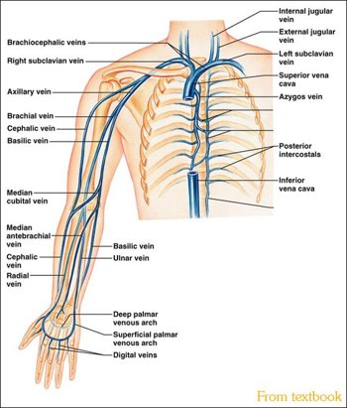
For example: Note the top-down “flow”.
Veins: Use Part 1: https://www.youtube.com/watch?v=sI6yXy3u2sI and Part II https://www.youtube.com/watch?v=ZQd73stLZl8
(or search “Veins of the Body video”) to compare and to learn the veins. Think: “Veins Drain” + “Arteries Away” (from heart)
Find the similarities and patterns to help you learn only these:
Superior Vena (means vein) Cava (2 branches become 1 as they move to the heart)
R and L Brachiocephalic Vein
Subclavian Vein
Internal and external jugular veins
Axillary Vein→Brachial OR Basilic –>Median cubital

Slide 29
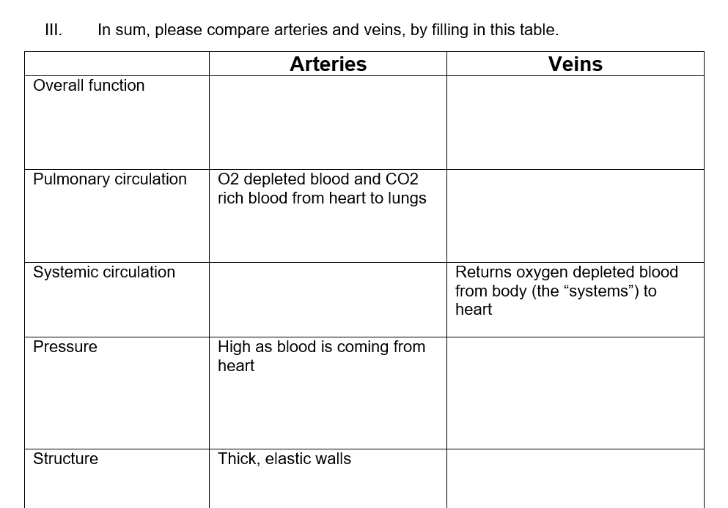
Lab Anatomy B p.3. SKIP as a reward for paying attention.

Slide 30
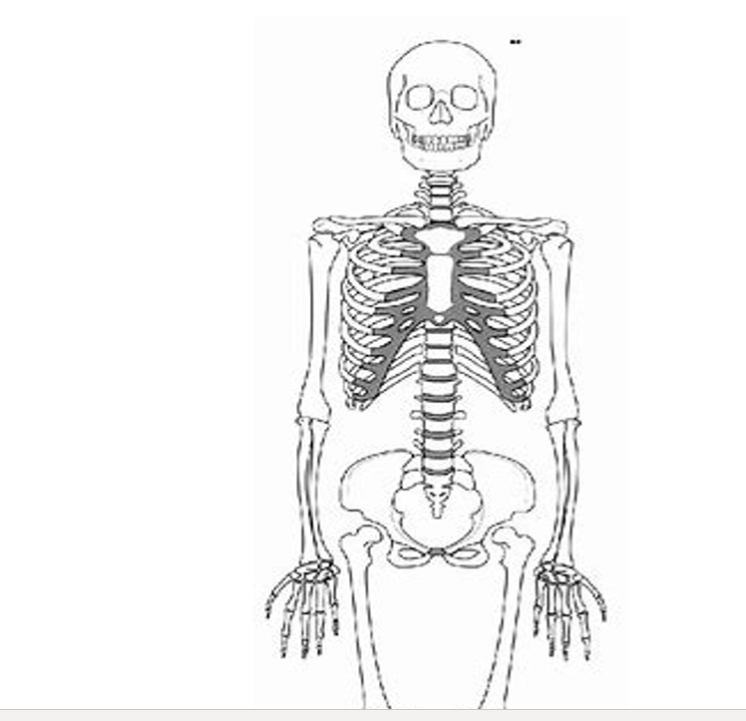
Lab Anatomy B p.4

Slide 31
Setting up for Success
Week 6: October 2 and 4 | Vessels: Read 20. Sections 1-6 Artherosclerosis article, osmotic exchange. Your work on vessels is largely Anatomy and Memorization using Visible Body and the blank diagrams. | RRM 20 and NO VB Quizzes Start Vaccine/Immune System paper SKIP Case; COVID Serology (see directions on Moodle)
 |  | LAB A: PhysioEx 5 Act 4-7 only. PRE-READ! Lab B: diagram NO Visible Body
Week 7: Oct. 9 & 11 | Lymphatic and Immunity Read 21 Sections 1 and 2, and 22 Sections 1-4, 7. | RRM 21 & 22, videos and images on HIV and inflammation
 |  | LAB: PhysioEx 12 Do Act. 1,3,4 only Ch. 22 (only) Visible Body

